Slide 1
Structure Programming
ICT-1105
Information and Communication Technology
Lecture-08
Date:

Slide 2
Class contents has given in Google Classroom with code
nhauiw4

Slide 3
VARIABLES
A variable is a name of memory location. It is used to store data. Variables are changeable, we can change value of a variable during execution of a program. . It can be reused many times.
A data type is associated with each variable & it decides what values the variable can take.

Slide 4
VARIABLES
When you decide your program needs another variable, you simply declare (or define) a new variable and C makes sure you get it.
You declare all C variables at the top of whatever blocks of code need them.
Variable are nothing but identifiers.

Slide 5
Rules to write variable names
A variable name contains maximum of 30 characters/ Variable name must be up to 8 characters.
A variable name includes alphabets and numbers, but it must start with an alphabet.
It cannot accept any special characters, blank spaces except underscore( _ ).
It should not be a reserved word.

Slide 6
Rules to write variable names
A variable name contains maximum of 30 characters/ Variable name must be up to 8 characters.
A variable name includes alphabets and numbers, but it must start with an alphabet.
It cannot accept any special characters, blank spaces except underscore( _ ).
It should not be a reserved word.
Ex : i rank1 MAX min Student_name
StudentName class_mark

Slide 7
Declaration of Variables
A variable can be used to store a value of any data type. The declaration of variables must be done before they are used in the program.
There are two places where you can declare a variable:
1. After the opening brace of a block of code (usually at the top of a function)
2. Before a function name (such as before main() in the program)

Slide 8
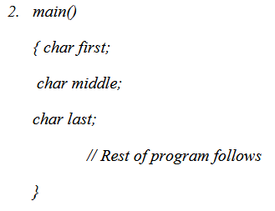
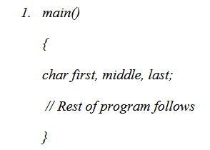
Declaration of Variables
Suppose you had to keep track of a person's first, middle, and last initials. Because an initial is obviously a character, it would be prudent to declare three character variables to hold the three initials. In C, you could do that with the following statement:

Slide 9
Declaration of Variables
The general format for declaring a variable:
Syntax : data_type variable-1,variable-2,------, variable-n;
Variables are separated by commas and declaration statement ends with a semicolon.
Ex : int x,y,z;
float a,b;
char m,n;

Slide 10
Assigning values to variables
values can be assigned to variables using the assignment operator (=). The general format statement is :
Syntax : variable = constant;
Ex :
x=100;
a= 12.25;
m=‘f’;

Slide 11
Initialization of Variables
When a variable is declared, it contains undefined value commonly known as garbage value. If we want we can assign some initial value to the variables during the declaration itself. This is called initialization of the variable.
Ex:
int pageno=10;
char grade=’A’;
float salary= 20000.50;

Slide 12
Types of Variables
There are many types of variables in c:
1. local variable
2. global variable
3. static variable

Slide 13
Formatted and Unformatted Console I/O Functions
Input / Output (I/O) Functions :
In ‘C’ language, two types of Input/Output functions are available, and all input and output operations are carried out through function calls. Several functions are available for input / output operations in ‘C’. These functions are collectively known as the standard i/o library.

Slide 14
Formatted and Unformatted Console I/O Functions
Input: In any programming language input means to feed some data into program. This can be given in the form of file or from command line.
Output: In any programming language output means to display some data on screen, printer or in any file.

Slide 15
Formatted and Unformatted Console I/O Functions
The Standard Files:
C programming treats all the devices as files. So devices such as the display are addressed in the same way as files and the following three files are automatically opened when a program executes to provide access to the keyboard and screen.

Slide 16
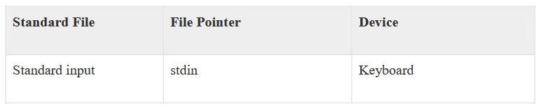
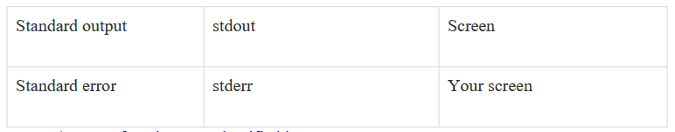
Formatted and Unformatted Console I/O Functions
The Standard Files:

Slide 17
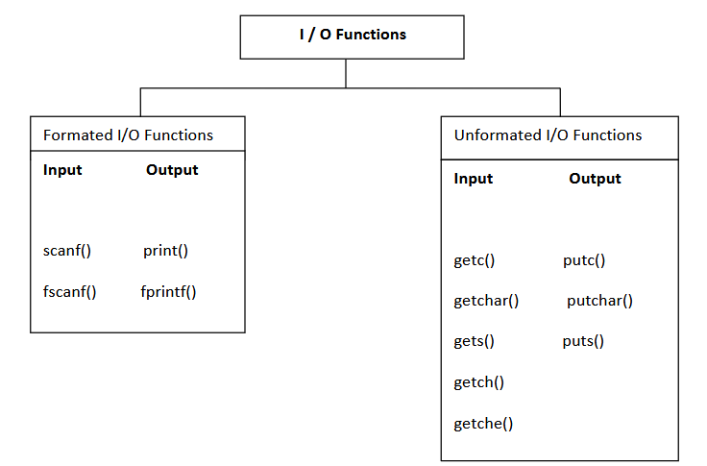
Formatted and Unformatted Console I/O Functions
Input / Output functions are classified into two types

Slide 18
Formatted and Unformatted Console I/O Functions
Formated I/O Functions :
Formatted I/O functions operates on various types of data.
1 : printf() : output data or result of an operation can be displayed from the computer to a standard output device using the library function printf(). This function is used to print any combination of data.
Syntax : printf(“control string “, variable1, variable2, -----------, variablen);
Ex : printf(“%d”,3977); // Output: 3977

Slide 19
Formatted and Unformatted Console I/O Functions
Formated I/O Functions :
printf() statement another syntax :
Syntax : printf(“fomating string”);
Formating string : it prints all the character given in double quotes (“ “) except formatting specifier.
Ex : printf(“ hello “);-> hello
printf(“a”); -> a
printf(“%d”, a); -> a value
printf(“%d”); -> no display

Slide 20
Formatted and Unformatted Console I/O Functions
#include <stdio.h> //This is needed to run printf() function.
int main()
{
printf("C Programming"); //displays the content inside quotation
return 0;
}
Output:
C Programming

Slide 21
Formatted and Unformatted Console I/O Functions
Explanation:
Every program starts from main() function.
printf() is a library function to display output which only works if #include<stdio.h>is included at the beginning.
Here, stdio.h is a header file (standard input output header file) and #include is command to paste the code from the header file when necessary. When compiler encounters printf()function and doesn't find stdio.h header file, compiler shows error.
return 0; indicates the successful execution of the program.

Slide 22
Formatted and Unformatted Console I/O Functions
Input- Output of integers in C
#include<stdio.h>
int main()
{
int c=5;
printf("Number=%d",c);
return 0;
}
Output
Number=5

Slide 23
Formatted and Unformatted Console I/O Functions
Input- Output of integers in C
Inside quotation of printf() there, is a conversion format string "%d" (for integer). If this conversion format string matches with remaining argument, i.e, c in this case, value of c is displayed.

Slide 24
Formatted and Unformatted Console I/O Functions
scanf() : input data can be entered into the computer using the standard input ‘C’ library function called scanf(). This function is used to enter any combination of input.
Syntax : scanf(“control string “,&var1, &var2,----, &varn);
The scanf() function is used to read information from the standard input device (keyboard).
Ex : scanf(“ %d “,&a);-> hello
Each variable name (argument) must be preceeded by an ampersand (&). The (&) symbol gives the meaning “address of “ the variable.

Slide 25
Formatted and Unformatted Console I/O Functions
#include<stdio.h>
int main()
{ int c;
printf("Enter a number\n");
scanf("%d",&c);
printf("Number=%d",c);
return 0;
}
Output
Enter a number
4
Number=4

Slide 26
Formatted and Unformatted Console I/O Functions
The scanf() function is used to take input from user. In this program, the user is asked an input
and value is stored in variable c. Note the '&' sign before c. &c denotes the address of c and value is stored in that address.

Slide 27
Formatted and Unformatted Console I/O Functions
Input- Output of floats in C
#include <stdio.h>
int main()
{
float a;
printf("Enter value: ");
scanf("%f",&a);
printf("Value=%f",a); //%f is used for floats instead of %d
return 0;
}
Output
Enter value: 23.45
Value=23.450000

Slide 28
Formatted and Unformatted Console I/O Functions
Input- Output of floats in C
Conversion format string "%f" is used for floats to take input and to display floating value of a variable.

Slide 29
Formatted and Unformatted Console I/O Functions
Input - Output of characters
#include <stdio.h>
int main()
{
char var1;
printf("Enter character: ");
scanf("%c",&var1);
printf("You entered %c.",var1);
return 0;
}
Output
Enter character: g
You entered g.
Conversion format string "%c" is used in case of characters.

Slide 30
Formatted and Unformatted Console I/O Functions
Input - Output of ASCII code
When character is typed in the previous program, the character itself is not recorded. A numeric value (ASCII value) is stored. And when we displayed that value by using "%c", that character is displayed.

Slide 31
Formatted and Unformatted Console I/O Functions
Input - Output of ASCII code
#include <stdio.h>
int main()
{
char var1;
printf("Enter character: ");
scanf("%c",&var1);
printf("You entered %c.\n",var1);
/* \n prints the next line(performs work of enter). */
printf("ASCII value of %d",var1);
return 0;
}
Output:
Enter character:
g
You entered g
ASCII value of 103
When, 'g' is entered, ASCII value 103 is stored instead of g.

Slide 32
Formatted and Unformatted Console I/O Functions
Input - Output of ASCII code
You can display character if you know ASCII code only. This is shown by following example.
#include <stdio.h>
int main()
{
int var1=69;
printf("Character of ASCII value 69: %c",var1);
return 0;
}
Output
Character of ASCII value 69: E

Slide 33
Formatted and Unformatted Console I/O Functions
Input - Output of ASCII code
he ASCII value of 'A' is 65, 'B' is 66 and so on to 'Z' is 90. Similarly ASCII value of 'a' is 97, 'b‘ is 98 and so on to 'z' is 122.

Slide 34
FORMATTED INPUT-OUTPUT
Data can be entered & displayed in a particular format. Through format specifications, better presentation of results can be obtained.
Variations in Output for integer & floats given to next slide.

Slide 35
FORMATTED INPUT-OUTPUT
#include<stdio.h>
int main()
{
printf("Case 1:%6d\n",9876);
/* Prints the number right justified within 6 columns */
printf("Case 2:%3d\n",9876);
/* Prints the number to be right justified to 3 columns but, there are 4 digits so number is not right justified */
printf("Case 3:%.2f\n",987.6543);
/* Prints the number rounded to two decimal places */
printf("Case 4:%.f\n",987.6543);
/* Prints the number rounded to 0 decimal place, i.e, rounded to integer */
printf("Case 5:%e\n",987.6543);
/* Prints the number in exponential notation (scientific notation) */
return 0;
}

Slide 36
FORMATTED INPUT-OUTPUT
Output
Case 1: 9876
Case 2:9876
Case 3:987.65
Case 4:988
Case 5:9.876543e+002

Slide 37
FORMATTED INPUT-OUTPUT
Data can be entered & displayed in a particular format. Through format specifications, better presentation of results can be obtained.
Variations in Output for integer & floats given to next slide.

Slide 38
FORMATTED INPUT-OUTPUT
Data can be entered & displayed in a particular format. Through format specifications, better presentation of results can be obtained.
Variations in Output for integer & floats given to next slide.

Slide 39
Formatted and Unformatted Console I/O Functions
Unformatted I/O functions:
a) Character I/O
b) String I/O

Slide 40
Formatted and Unformatted Console I/O Functions
a) character I/O:
1. getchar(): Used to read a character from the standard input
2. putchar(): Used to display a character to standard output
3. getch() and getche(): these are used to take the any alpha numeric characters from the standard input
getche() read and display the character
getch() only read the single character but not display
4. putch(): Used to display any alpha numeric characters to standard output

Slide 41
Formatted and Unformatted Console I/O Functions
b) String I/O:
1. gets(): Used for accepting any string from the standard input(stdin)
eg:gets()
2. puts(): Used to display a string or character array Eg:puts()
3. Cgets():read a string from the console eg; cgets(char *st)
4. Cputs():display the string to the console eg; cputs(char *st)

Slide 42
OPERATORS
An operator is a Symbol that ells the compiler to perform specific mathematical or logical manipulation. An operators acts some variables are called operands to get the desired result.
Ex : a+b;
Where a,b are operands and + is the operator.

Slide 43
Types of Operators
C language is rich in built-in operators and provides the following types of operators:
1) Arithmetic Operators.
2) Relational Operators.
3) Logical Operators.
4) Assignment Operators.
5). Unary Operators.
6) Conditional Operators.
7) Special Operators.
8) Bitwise Operators.
9) Shift Operators.

Slide 44
Arithmetic Operators
An arithmetic operator performs mathematical operations such as addition, subtraction and multiplication on numerical values (constants and variables).

Slide 45
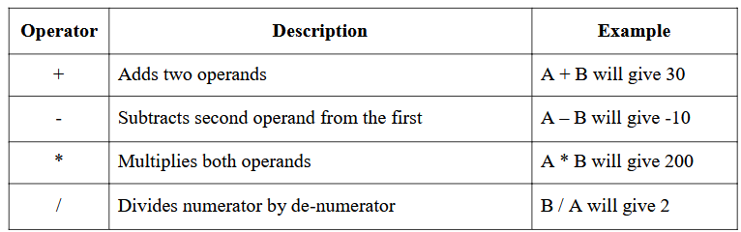
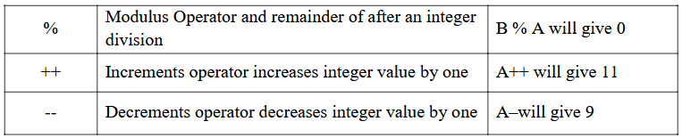
Arithmetic Operators
Following table shows all the arithmetic operators supported by C language. Assume variable A holds 10 and variable B holds 20 then:

Slide 46
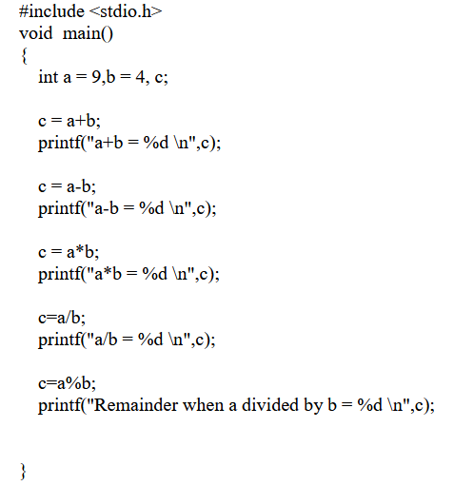
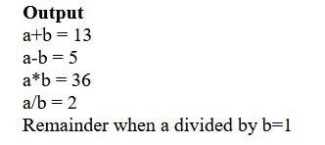
Arithmetic Operators

Slide 47
Relational Operators
Relational operator checks the relationship between two operands.
If the relation is true, it returns 1; if the relation is false, it returns value 0.
Operands may be variables, constants or expressions.
Relational operators are used in decision making and loops.

Slide 48
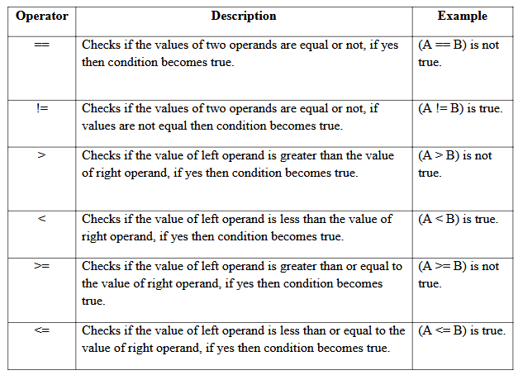
Relational Operators

Slide 49
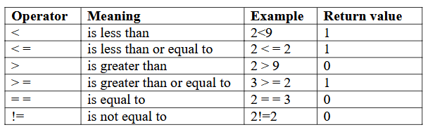
Relational Operators

Slide 50
Relational Operators
// C Program to demonstrate the working of relational operators
#include <stdio.h>
int main()
{
int a = 5, b = 5, c = 10;
printf("%d == %d = %d \n", a, b, a == b); // true
printf("%d == %d = %d \n", a, c, a == c); // false
printf("%d > %d = %d \n", a, b, a > b); //false
printf("%d > %d = %d \n", a, c, a > c); //false

Slide 51
Relational Operators
printf("%d < %d = %d \n", a, b, a < b); //false
printf("%d < %d = %d \n", a, c, a < c); //true
printf("%d != %d = %d \n", a, b, a != b); //false
printf("%d != %d = %d \n", a, c, a != c); //true
printf("%d >= %d = %d \n", a, b, a >= b); //true
printf("%d >= %d = %d \n", a, c, a >= c); //false
printf("%d <= %d = %d \n", a, b, a <= b); //true
printf("%d <= %d = %d \n", a, c, a <= c); //true
return 0;
}

Slide 52
Relational Operators
Output
5 == 5 = 1
5 == 10 = 0
5 > 5 = 0
5 > 10 = 0
5 < 5 = 0
5 < 10 = 1
5 != 5 = 0
5 != 10 = 1
5 >= 5 = 1
5 >= 10 = 0
5 <= 5 = 1
5 <= 10 = 1

Slide 53
Logical Operators
These operators are used to combine the results of two or more conditions. An expression containing logical operator returns either 0 or 1 depending upon whether expression results true or false. Logical operators are commonly used in decision making in C programming.

Slide 54
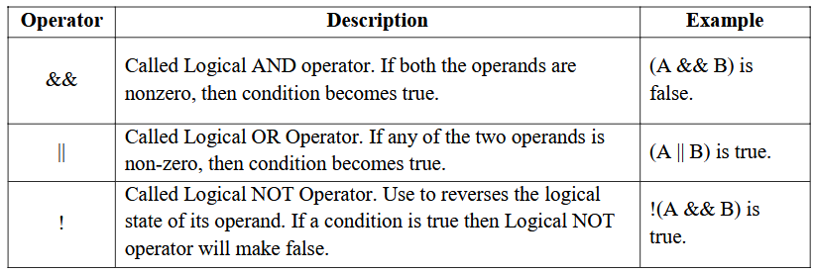
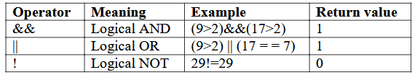
Logical Operators

Slide 55
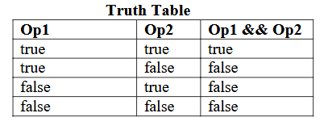
Logical Operators
Logical AND : If any one condition false the complete condition becomes false.

Slide 56
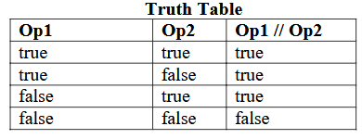
Logical Operators
Logical OR : If any one condition true the complete condition becomes true.

Slide 57

Logical Operators
Logical Not : This operator reverses the value of the expression it operates on i.e, it makes a true expression false and false expression true.

Slide 58
Logical Operators
// C Program to demonstrate the working of logical operators
#include <stdio.h>
int main()
{
int a = 5, b = 5, c = 10, result;
result = (a = b) && (c > b);
printf("(a = b) && (c > b) equals to %d \n", result);
result = (a = b) && (c < b);
printf("(a = b) && (c < b) equals to %d \n", result);
result = (a = b) || (c < b);
printf("(a = b) || (c < b) equals to %d \n", result);
result = (a != b) || (c < b);
printf("(a != b) || (c < b) equals to %d \n", result);
result = !(a != b);
printf("!(a == b) equals to %d \n", result);
result = !(a == b);
printf("!(a == b) equals to %d \n", result);
return 0;
}

Slide 59
Logical Operators
Output:
(a = b) && (c > b) equals to 1
(a = b) && (c < b) equals to 0
(a = b) || (c < b) equals to 1
(a != b) || (c < b) equals to 0
!(a != b) equals to 1
!(a == b) equals to 0

Slide 60
Assignment Operators
Assignment operators are used to assign a value (or) an expression (or) a value of a variable to another variable.
Syntax :
variable name=expression (or) value (or) variable
Ex : x=10;
y=a+b;
z=p;

Slide 61
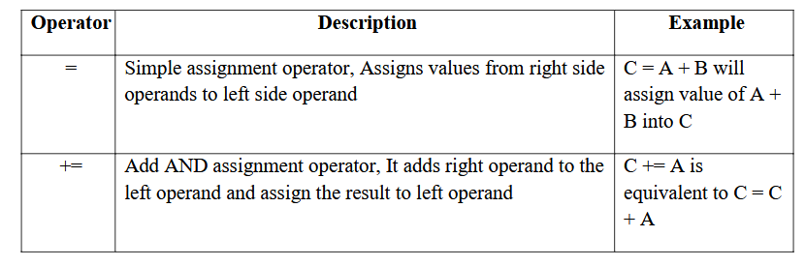
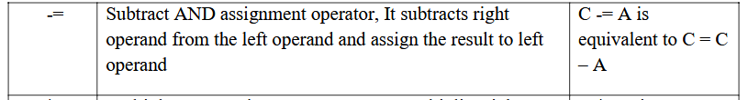
Assignment Operators

Slide 62
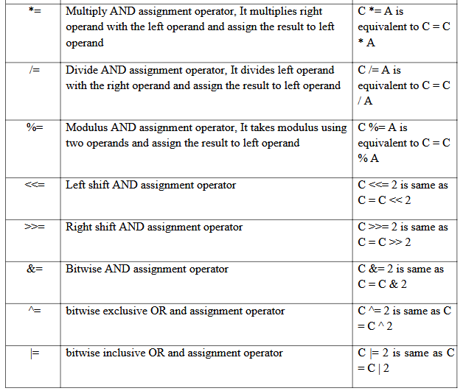
Assignment Operators

Slide 63
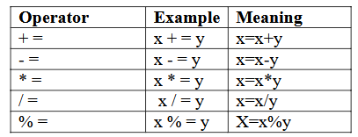
Compound assignment operator
‘C’ provides compound assignment operators to assign a value to variable in order to assign a new value to a variable after performing a specified operation.

Slide 64
Assignment Operators
// C Program to demonstrate the working of assignment operators
#include <stdio.h>
int main()
{
int a = 5, c;
c = a;
printf("c = %d \n", c);
c += a; // c = c+a
printf("c = %d \n", c);
c -= a; // c = c-a
printf("c = %d \n", c);
c *= a; // c = c*a
printf("c = %d \n", c);
c /= a; // c = c/a
printf("c = %d \n", c);
c %= a; // c = c%a
printf("c = %d \n", c);
return 0;
}

Slide 65
Assignment Operators
Output
c = 5
c = 10
c = 5
c = 25
c = 5
c = 0

Slide 66
Increment and Decrement Operators /Unary Operators
Unary operators are having higher priority than the other operators. Unary operators, meaning they only operate on a single operand.
Increment Operator in C Programming
1. Increment operator is used to increment the current value of variable by adding integer 1.
2. Increment operator can be applied to only variables.
3. Increment operator is denoted by ++.

Slide 67
Increment and Decrement Operators /Unary Operators
We have two types of increment operator i.e Pre-Increment and Post-Increment Operator.
Pre-Increment
Pre-increment operator is used to increment the value of variable before using in the expression. In the Pre-Increment value is first incremented and then used inside the expression.
b = ++y;

Slide 68
Increment and Decrement Operators /Unary Operators
Pre-Increment
b = ++y;
In this example suppose the value of variable ‘y’ is 5 then value of variable ‘b’ will be 6 because the value of ‘y’ gets modified before using it in a expression.

Slide 69
Increment and Decrement Operators /Unary Operators
Post-Increment
Post-increment operator is used to increment the value of variable as soon as after executing expression completely in which post increment is used. In the Post-Increment value is first used in a expression and then incremented.
b = x++;
In this example suppose the value of variable ‘x’ is 5 then value of variable ‘b’ will be 5 because
old value of ‘x’ is used.

Slide 70
Increment and Decrement Operators /Unary Operators
Note :
We cannot use increment operator on the constant values because increment operator operates on only variables. It increments the value of the variable by 1 and stores the incremented value back to the variable
b = ++5;
or
b = 5++;

Slide 71
Increment and Decrement Operators /Unary Operators
The syntax of the operators is given below
++<variable name> --<variable name>
<variable name>++ <variable name>--
The operator ++ adds 1 to the operand and -- subtracts 1 from the operand. These operators in two forms : prefix (++x) and postfix(x++).

Slide 72
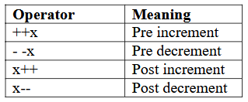
Increment and Decrement Operators /Unary Operators
The syntax of the operators is given below
Where
1 : ++x : Pre increment, first increment and then do the operation.
2 : - -x : Pre decrement, first decrements and then do the operation.
3 : x++ : Post increment, first do the operation and then increment.
4 : x- - : Post decrement, first do the operation and then decrement.

Slide 73
Increment and Decrement Operators /Unary Operators
Let a=5 and b=10
a++; //a becomes 6
a--; //a becomes 5
++a; //a becomes 6
--a; //a becomes 5
When ++ is used as prefix(like: ++var), ++var will increment the value of var and then return it but, if ++ is used as postfix(like: var++), operator will return the value of operand first and then only increment it. This can be demonstrated by an example:

Slide 74
Increment and Decrement Operators /Unary Operators
#include <stdio.h>
int main()
{
int c=2,d=2;
printf(“%d\n”,c++); //this statement displays 2 then, only c incremented by 1 to 3.
printf(“%d”,++c); //this statement increments 1 to c then, only c is displayed.
Return 0;
}
Output
2
4

Slide 75
Increment and Decrement Operators /Unary Operators
// C Program to demonstrate the working of increment and decrement operators
#include <stdio.h>
int main()
{
int a = 10, b = 100;
float c = 10.5, d = 100.5;
printf("++a = %d \n", ++a);
printf("--b = %d \n", --b);
printf("++c = %f \n", ++c);
printf("--d = %f \n", --d);
return 0;
}

Slide 76
Increment and Decrement Operators /Unary Operators
Output
++a = 11
--b = 99
++c = 11.500000
--d = 99.500000

Slide 77
Increment and Decrement Operators /Unary Operators
Multiple increment operators inside printf
#include<stdio.h>
void main()
{
int i = 1;
printf("%d %d %d", i, ++i, i++);
}
Output: ???

Slide 78


Increment and Decrement Operators /Unary Operators
Output : 3 3 1
Pictorial representation

Slide 79
Increment and Decrement Operators /Unary Operators
Explanation of program
1. Whenever more than one format specifiers (i.e %d) are directly or indirectly related with same variable (i,i++,++i) then we need to evaluate each individual expression from right to left.
2. As shown in the previous image evaluation sequence of expressions written inside printf will be – i++,++i,i
3. After execution we need to replace the output of expression at appropriate place

Slide 80
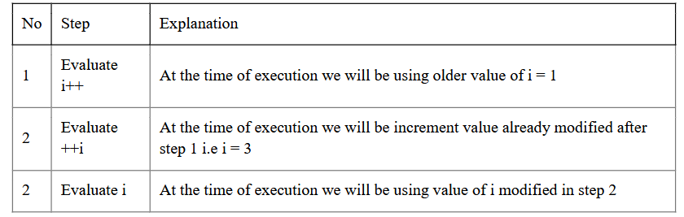
Increment and Decrement Operators /Unary Operators
Explanation of program

Slide 81
Increment and Decrement Operators /Unary Operators
Postfix and Prefix Expression in Same Statement
#include<stdio.h>
#include<conio.h>
void main() {
int i = 0, j = 0;
j = i++ + ++i;
printf("%d\n", i);
printf("%d\n", j);
}
Output :
2
2

Slide 82
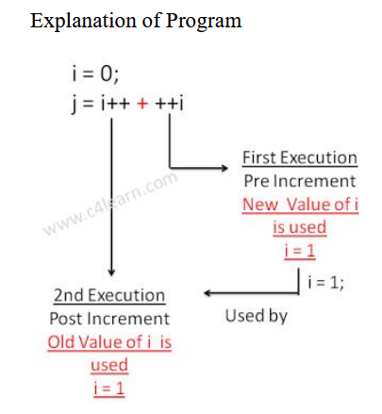
Increment and Decrement Operators /Unary Operators
Postfix and Prefix Expression in Same Statement
#include<stdio.h>
#include<conio.h>
void main() {
int i = 0, j = 0;
j = i++ + ++i;
printf("%d\n", i);
printf("%d\n", j);
}
Output :
2
2

Slide 83
Conditional Operator/ Ternary operator (? :)
conditional operator checks the condition and executes the statement depending of the condition. A conditional operator is a ternary operator, that is, it works on 3 operands.
Conditional operator consist of two symbols.
1 : question mark (?).
2 : colon ( : ).

Slide 84
Conditional Operator/ Ternary operator (? :)
Syntax : condition ? exp1 : exp2;
It first evaluate the condition, if it is true (non-zero) then the “exp1” is evaluated, if the condition is false (zero) then the “exp2” is evaluated.

Slide 85
Conditional Operator/ Ternary operator (? :)
#include <stdio.h>
int main(){
char February;
int days;
printf("If this year is leap year, enter 1. If not enter any integer: ");
scanf("%c",&February);
// If test condition (February == 'l') is true, days equal to 29.
// If test condition (February =='l') is false, days equal to 28.
days = (February == '1') ? 29 : 28;
printf("Number of days in February = %d",days);
return 0;
}

Slide 86
Conditional Operator/ Ternary operator (? :)
#include <stdio.h>
int main(){
char February;
int days;
printf("If this year is leap year, enter 1. If not enter any integer: ");
scanf("%c",&February);
// If test condition (February == 'l') is true, days equal to 29.
// If test condition (February =='l') is false, days equal to 28.
days = (February == '1') ? 29 : 28;
printf("Number of days in February = %d",days);
return 0;
}
Output
If this year is leap year, enter 1. If not enter any integer: 1
Number of days in February = 29

Slide 87
Bitwise Operators
Bitwise operators are used to manipulate the data at bit level. It operates on integers only. It may not be applied to float. In arithmetic-logic unit (which is within the CPU), mathematical operations like: addition, subtraction, multiplication and division are done in bit-level which makes processing faster and saves power. To perform bit-level operations in C programming, bitwise operators are used.

Slide 88
Bitwise Operators
Bitwise operators are used to manipulate the data at bit level. It operates on int and char only. It may not be applied to float and double. In arithmetic-logic unit (which is within the CPU), mathematical operations like: addition, subtraction, multiplication and division are done in bit-level which makes processing faster and saves power. To perform bit-level operations in C programming, bitwise operators are used.
Showbits( ) function can be used to display the binary representation of any integer or character value.

Slide 89
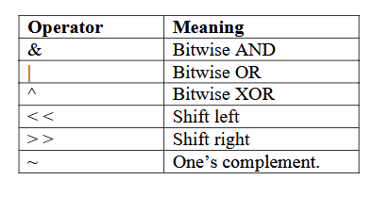
Bitwise Operators

Slide 90
Bitwise AND operator &
The output of bitwise AND is 1 if the corresponding bits of two operands is 1. If either bit of an operand is 0, the result of corresponding bit is evaluated to 0.
Let us suppose the bitwise AND operation of two integers 12 and 25.
12 = 00001100 (In Binary)
25 = 00011001 (In Binary)

Slide 91
Bitwise AND operator &
Bit Operation of 12 and 25
00001100
& 00011001
________
00001000 = 8 (In decimal)

Slide 92
Bitwise AND operator &
Example #1: Bitwise AND
#include <stdio.h>
int main()
{
int a = 12, b = 25;
printf("Output = %d", a&b);
return 0;
}
Output
Output =8

Slide 93
Bitwise OR operator |
The output of bitwise OR is 1 if at least one corresponding bit of two operands is 1. In C Programming, bitwise OR operator is denoted by |.
12 = 00001100 (In Binary)
25 = 00011001 (In Binary)
Bitwise OR Operation of 12 and 25
00001100
| 00011001
________
00011101 = 29 (In decimal)

Slide 94
Bitwise OR operator |
Example #2: Bitwise OR
#include <stdio.h>
int main()
{
int a = 12, b = 25;
printf("Output = %d", a|b);
return 0;
}
Output:
Output =29

Slide 95
Bitwise XOR (exclusive OR) operator ^
The result of bitwise XOR operator is 1 if the corresponding bits of two operands are opposite. It is denoted by ^.
12 = 00001100 (In Binary)
25 = 00011001 (In Binary)
Bitwise XOR Operation of 12 and 25
00001100
^ 00011001
________
00010101 = 21 (In decimal)

Slide 96
Bitwise complement operator ~
Bitwise compliment operator is an unary operator (works on only one operand). It changes 1 to 0 and 0 to 1. It is denoted by ~.
35 = 00100011 (In Binary)
Bitwise complement Operation of 35
~00100011
________
11011100 = 220 (In decimal)

Slide 97
Twist in bitwise complement operator
The bitwise complement of 35 (~35) is -36 instead of 220, but why?
For any integer n, bitwise complement of n will be -(n+1). To understand this, you should have the knowledge of 2's complement.

Slide 98
Twist in bitwise complement operator
2's Complement:
Two's complement is an operation on binary numbers. The 2's complement of a number is equal to the complement of that number plus 1. For example:

Slide 99
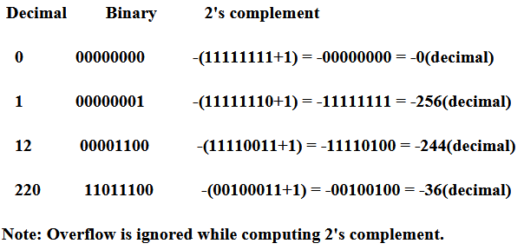
Twist in bitwise complement operator
2's Complement:

Slide 100
Twist in bitwise complement operator
2's Complement:
The bitwise complement of 35 is 220 (in decimal). The 2's complement of 220 is -36. Hence, the
output is -36 instead of 220.
Bitwise complement of any number N is -(N+1). Here's how:
bitwise complement of N = ~N (represented in 2's complement form)
2'complement of ~N= -(~(~N)+1) = -(N+1)

Slide 101
Twist in bitwise complement operator
Example #4: Bitwise complement
#include <stdio.h>
int main()
{
printf("complement = %d\n",~35);
printf("complement = %d\n",~-12);
return 0;
}
Output
Complement = -36
Complement = 11

Slide 102
Bitwise shift operators
There are two Bitwise shift operators in C programming:
Right shift operator
Left shift operator.
Right Shift Operator
Right shift operator shifts all bits towards right by certain number of specified bits. It is denoted by >>.
Left Shift Operator
Left shift operator shifts all bits towards left by certain number of specified bits. It is denoted by<<.

Slide 103
Operators
The Bitwise operators supported by C language are explained in the following table. Assume variable A holds 60 (00111100) and variable B holds 13 (00001101), then:

Slide 104
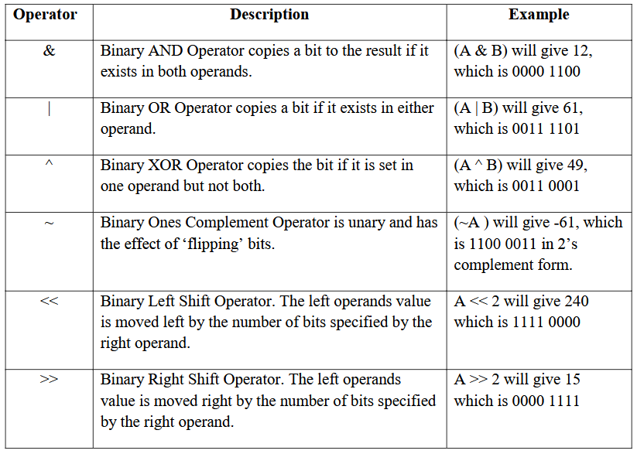
Operators

Slide 105
Special Operators
1 ) Comma Operator :The comma operator is used to separate the statement elements such as variables, constants or expressions, and this operator is used to link the related expressions together, such expressions can be evaluated from left to right and the value of right most expressions is the value of combined expressions
Ex : val(a=3, b=9, c=77, a+c)
First assigns the value 3 to a, then assigns 9 to b, then assigns 77 to c, and finaly80(3+77) to value.

Slide 106
Special Operators
2 ) Sizeof Operator : The sizeof() is a unary operator, that returns the length in bytes o the specified variable, and it is very useful to find the bytes occupied by the specified variable in the memory.
Syntax : sizeof(variable-name);
int a;
Ex : sizeof(a); //OUTPUT-----2bytes

Slide 107
Special Operators
Example #6: sizeof Operator
#include <stdio.h>
int main()
{
int a, e[10];
float b;
double c;
char d;
printf("Size of int=%lu bytes\n",sizeof(a));
printf("Size of float=%lu bytes\n",sizeof(b));
printf("Size of double=%lu bytes\n",sizeof(c));
printf("Size of char=%lu byte\n",sizeof(d));
printf("Size of integer type array having 10 elements = %lu bytes\n", sizeof(e));
return 0;
}
Output
Size of int = 4 bytes
Size of float = 4 bytes
Size of double = 8 bytes
Size of char = 1 byte
Size of integer type array having 10 elements = 40 bytes

Slide 108
Thank you….

